Slide 1

CHURN Data analysis

Slide 2
OBJECTIVE
Predicting which set of the Customers are going to churn out from the organization by looking into some of the important attributes and applying Machine Learning on it.
Customer churn refers to when a customer ceases his or her relationship with a company. Online churned once a particular amount of time has elapsed since the customers last interaction with the site or service.
Customer churn occurs when customers or subscribers stop doing business with a company or service, also known as customer attrition. Its also referred as loss of clients or customers. Similar concept with predicting employee turnover, we are going to predict customer churn.

Slide 3
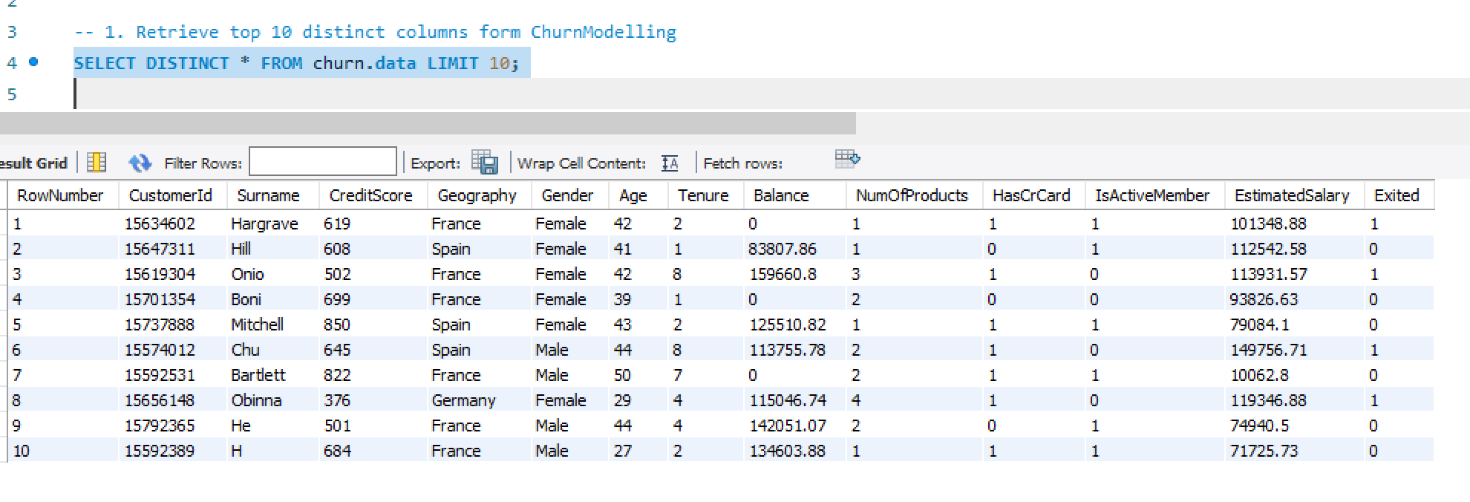
Q1:Retrieve tope 10 distinct columns form Churn data.
Query: Select Distinct * From Churn_data Limit 10;
Method Used: Select Statement, Distinct Statement, Limit clause
Explanation: the SQL query consists of three separate "SELECT" statements. Each "SELECT" statement retrieves data from a table: “churn.data”. "DISTINCT" statement is used to return only distinct values from the table. The "limit" clause allows users to control the amount of data retrieved and displayed in the result set. This allows you to retrieve 10 distinct rows from the table.

Slide 4
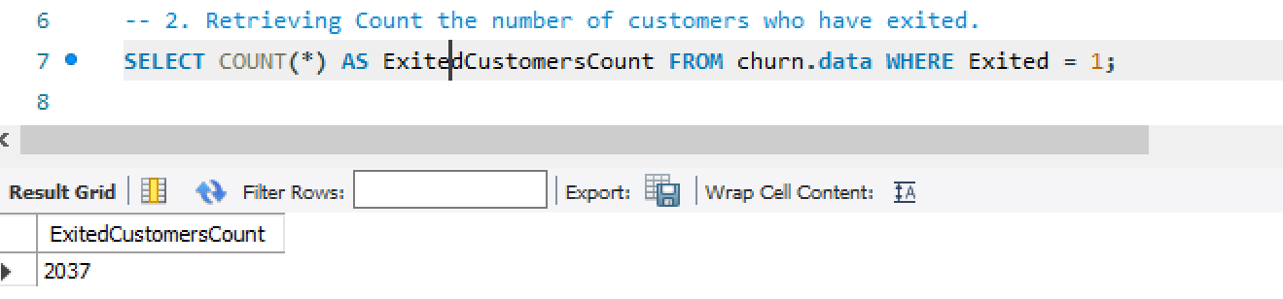
Q2:Retrieving Count the number of customers who have exited.
Query: Select Count(*) As ExitedCustomersCount From Churn.Data Where Exited = 1;
Method Used: Select Statement, Count Function
Explanation: The SQL query consists of three separate "SELECT" statements. Each "SELECT" statement retrieves data from a table: “churn.data”. "COUNT(*)" is an aggregate function used to count the number of rows in a table. This allows you to retrieve counts of rows from a table

Slide 5
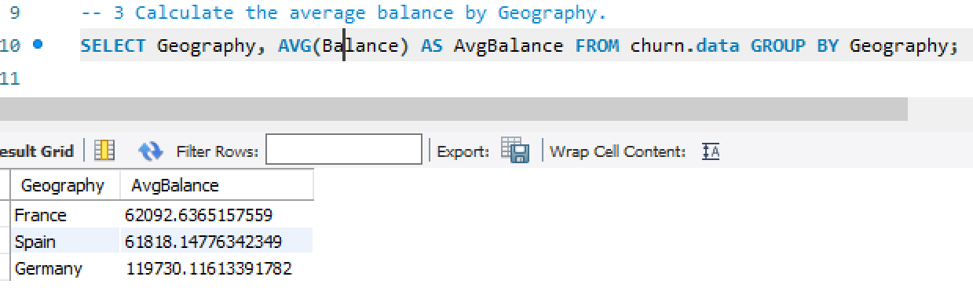
Q3. Calculate the average balance by Geography.
Query: Select Geography, Avg(Balance) As AvgBalance From churn.data Group By Geography;
Method Used: Select Statement, Average Function, Group By Clause
Explanation: "GROUP BY" clause groups the rows of the "churn.data" table by the values in the "Geography" column.Therefore, the query calculates the AVERAGE of Balance for each geography and groups the data by geography.

Slide 6
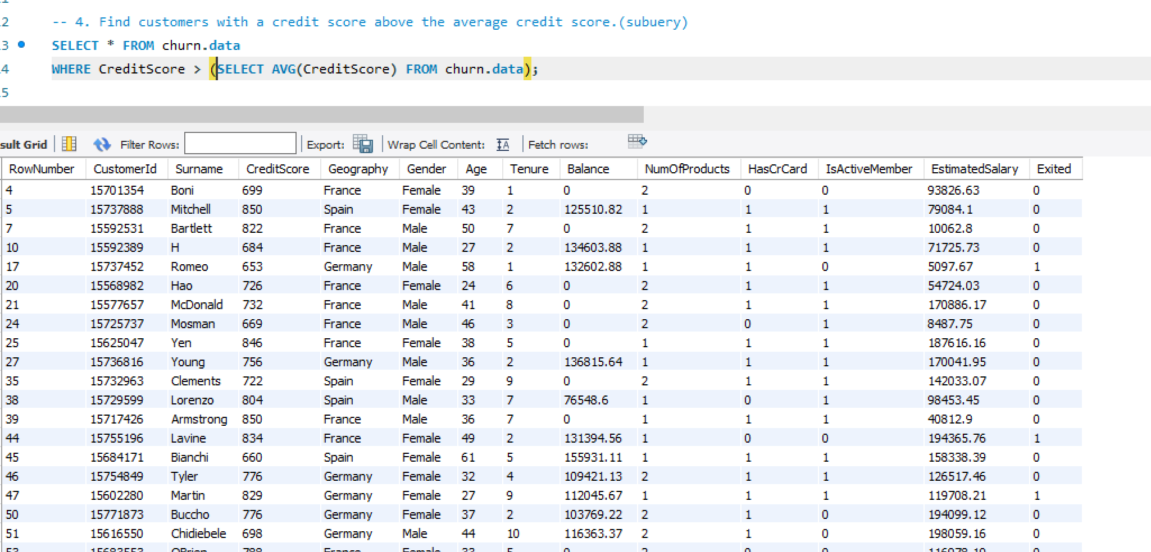
Q4. Find customers with a credit score above the average credit score.(subquery)
Query: Select * From churn.data Where CreditScore > (Select Avg(CreditScore) From churn.data);
Method Used: Select Statement, Average Function
Explanation: "SELECT" statement retrieves data from a table: "churn.data". "WHERE" Credit Score > is a condition that filters the rows to include only those where the Credit Score column has a value greater than subquery credit score value .

Slide 7
Q5. Retrieve customers who are active members and have more than two products. (Conditional Retrieval)
Query: Select * From churn.data Where IsActiveMember = 1 And NumofProducts > 2;
Method Used: Select Statemen, Where clause
Explanation: "SELECT" statement retrieves data from a table: "churn.data". Where Is Active Member = 1 AND Num Of Products > 2 is a condition that checks the rows to include only those where the Is Active Member is equal to 1 and Number Of Products greater than value 2 .

Slide 8
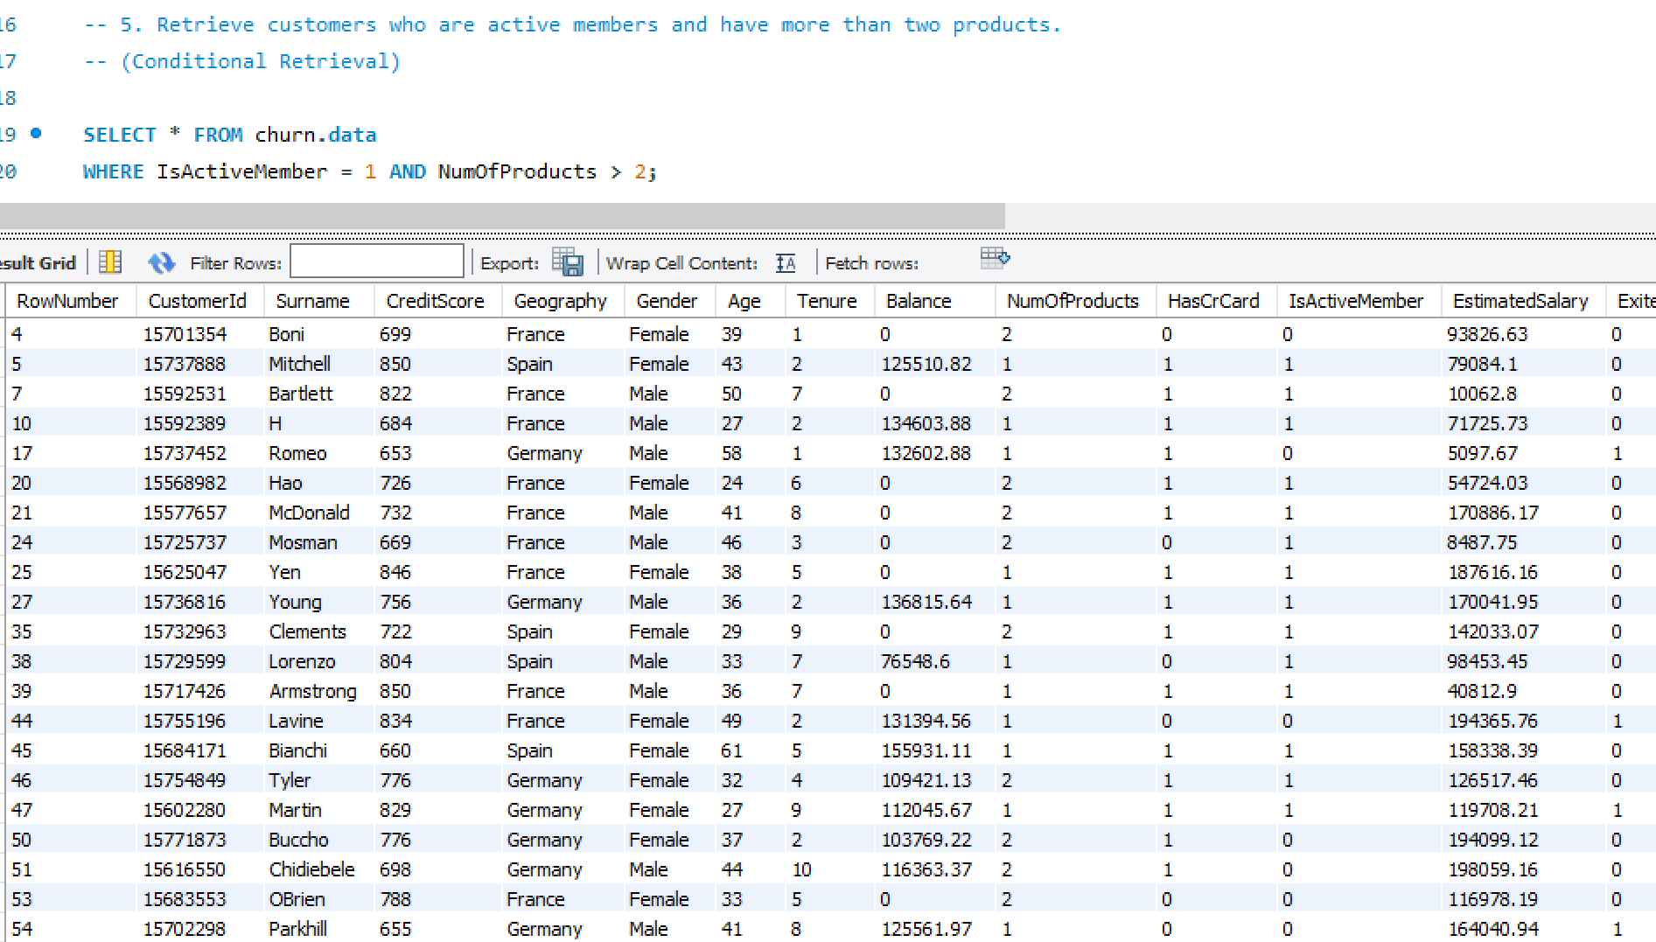
Code:

Slide 9
Q6. Determine the average balance and estimated salary for different age groups.
Query: SELECT CASE
WHEN Age < 30 THEN 'Under 30’
WHEN Age >= 30 AND Age < 40 THEN '30-39’
WHEN Age >= 40 AND Age < 50 THEN '40-49’
ELSE '50 and over’
END AS AgeGroup,
AVG(Balance) AS AvgBalance,
AVG(EstimatedSalary) AS AvgSalary
FROM churn.data
GROUP BY AgeGroup
ORDER BY AgeGroup;
Method Used: Select Statement, Average Function, Case statement, Group by Clause, Order by Clause

Slide 10
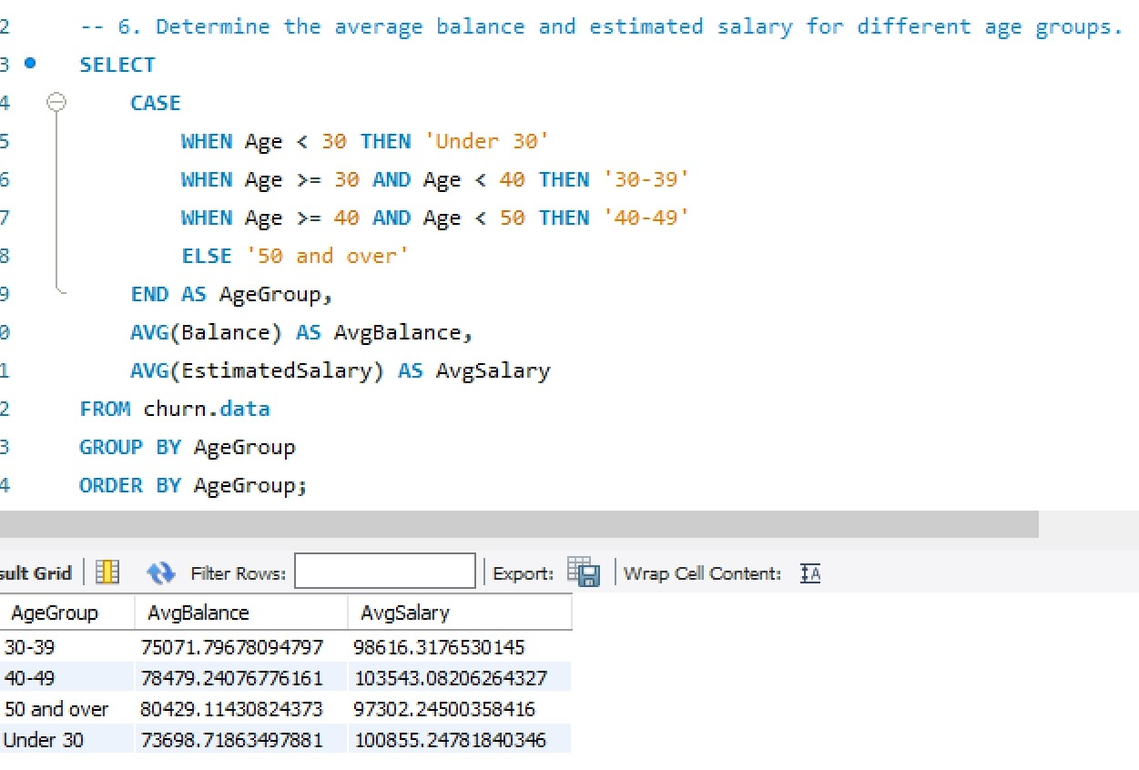
Explanation: Case statement is a conditional expression that allows users to execute different actions based on different conditions. Here when it checks for 3 age groups which are under 30, greater than 30 and lesser than 40,value greater than 40 and lesser than 50 else over 50 age group. Calculates the AVERAGE of balance column and renames it as AvgBalance calculates the AVERAGE of EstimatedSalary column and renames it as AvgSalary from table churn.data.
Code:

Slide 11
Q7. Calculate the churn rate (percentage of customers who have exited) and analyze churn behavior based on various factors.
Query: SELECT
Geography,
AVG(Exited) AS ChurnRate,
AVG(CreditScore) AS AvgCreditScore,
AVG(Balance) AS AvgBalance
FROM churn.data
GROUP BY Geography
ORDER BY ChurnRate DESC;
Method Used: Select Statement, Average Function, Group by Clause, Order by Clause
Explanation: Retrives the data by performing average of exited column, average of CreditScore as AvgCreditScore, average of Balance as AvgBalance from churn.data by grouping geography column.

Slide 12
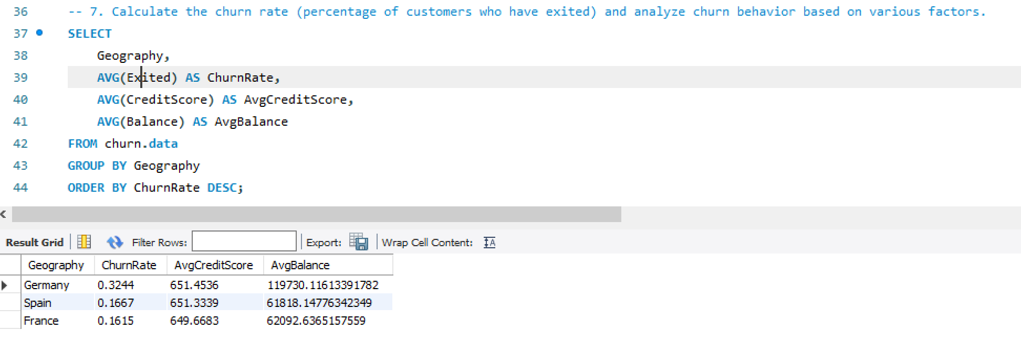
Code:

Slide 13
Q8. Implement dynamic segmentation based on real-time updates in customer behavior, such as changes in balance or product ownership. Example using window functions for dynamic segmentation
Query: SELECT
CustomerId,
Balance,
NumOfProducts,
ROW_NUMBER() OVER (PARTITION BY CustomerId ORDER BY Balance DESC) AS Segment
FROM churn.data;
Method Used: Select Statement, Average Function, Row Number( ) Over ( ) Function
Explanation: ROW_Number() SQL RANK function to get a unique sequential number for each row in the specified data. It gives the rank one for the first row and then increments the value by one for each row. We get different ranks for the row having similar values as well.

Slide 14
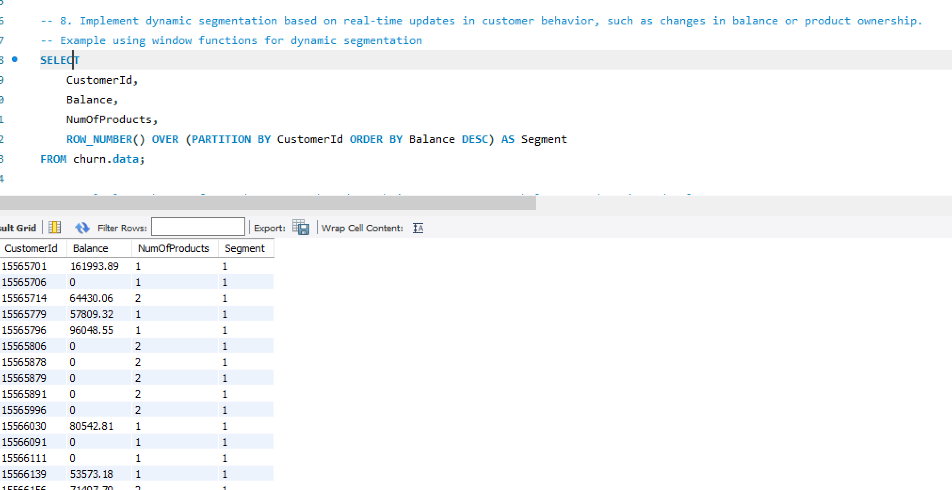
Code:

Slide 15
Q9. Calculate the CLV for each customer based on their tenure, average balance, and estimated salary.
Query: SELECT
CustomerId,
SUM(Balance) AS TotalBalance,
AVG(EstimatedSalary) AS AvgSalary,
Tenure,
(SUM(Balance) / Tenure) * AVG(EstimatedSalary) AS CLV
FROM churn.data
GROUP BY CustomerId, Tenure
ORDER BY CLV DESC;
Method Used: Select Statement, Average Function, Sum Function, Group By Clause
Explanation: Retrieves sum of balance and Calculates the CLV(customer life time valve) for each customer based on their tenure, average balance, and estimated salary in descending oder.

Slide 16
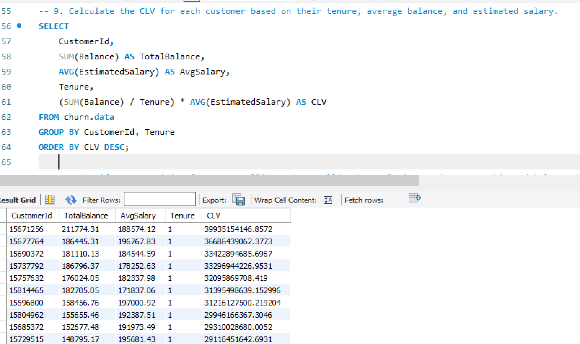
Code:

Slide 17
Q10. Identify opportunities for cross-selling and up-selling by analyzing product ownership and balance distribution.
Query: SELECT
NumOfProducts,
AVG(Balance) AS AvgBalance,
COUNT(*) AS CustomerCount
FROM churn.data
GROUP BY NumOfProducts
ORDER BY NumOfProducts;
Method Used: Select Statement, Average Function, Group By Clause
Explanation: Retreives cross-selling and up-selling of number of products by analyzing product ownership and balance distribution by grouping numberof products and orders by number of product

Slide 18
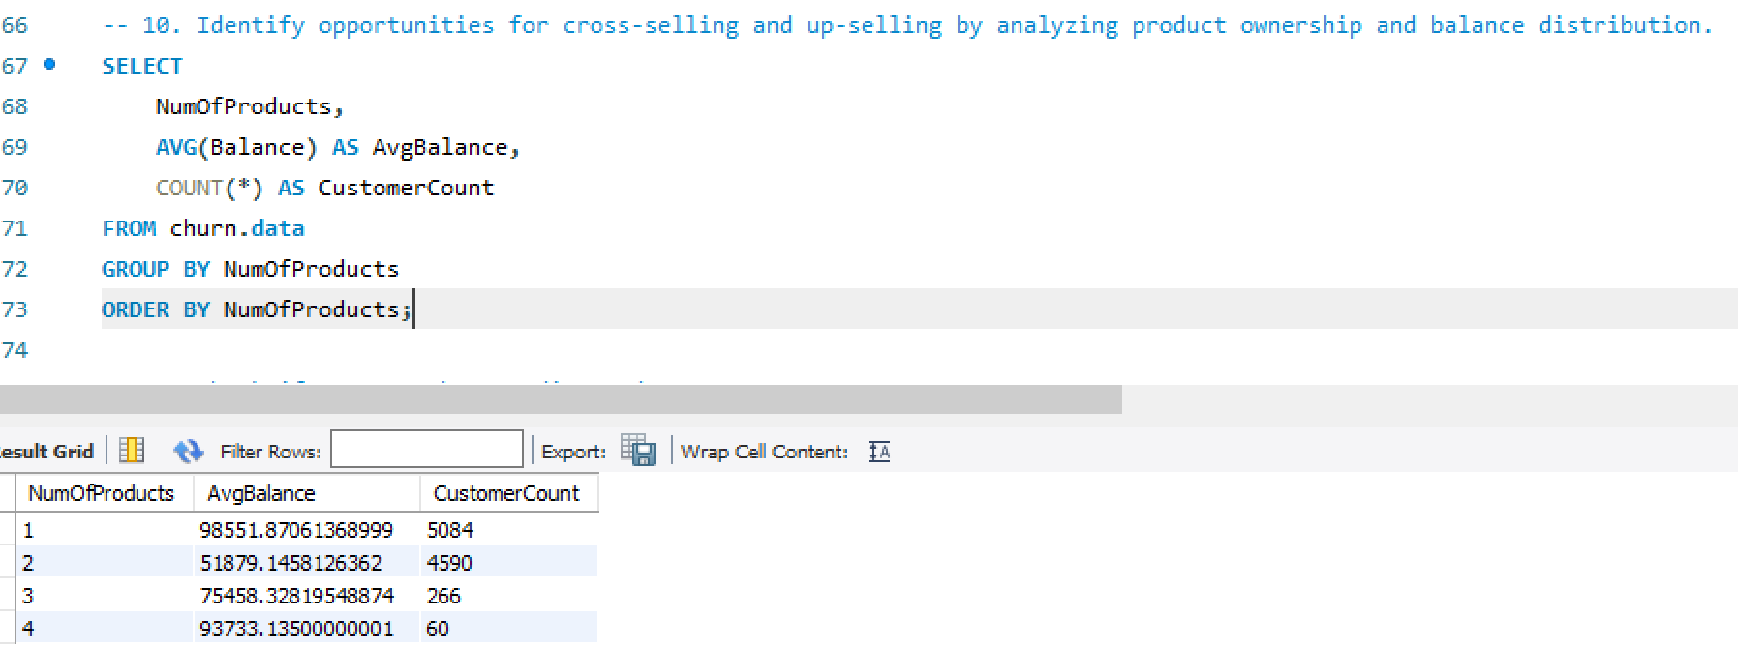
Code:

Slide 19
Q11. Check if Customer has Credit CardCreate a UDF to convert the HasCrCard column (which is likely a bit or Boolean) into a more readable format.
Query: DELIMITER //
CREATE FUNCTION HasCreditCard(hasCrCard BIT)
RETURNS VARCHAR(3)
BEGIN
DECLARE result VARCHAR(3);
SET result = CASE WHEN hasCrCard = 1 THEN 'Yes' ELSE 'No' END;
RETURN result;
END//
DELIMITER ;
SELECT CustomerId, Surname, HasCrCard, HasCreditCard(HasCrCard) AS HasCreditCard FROM churn.data;
Method Used: Select Statement, User Defined Function

Slide 20
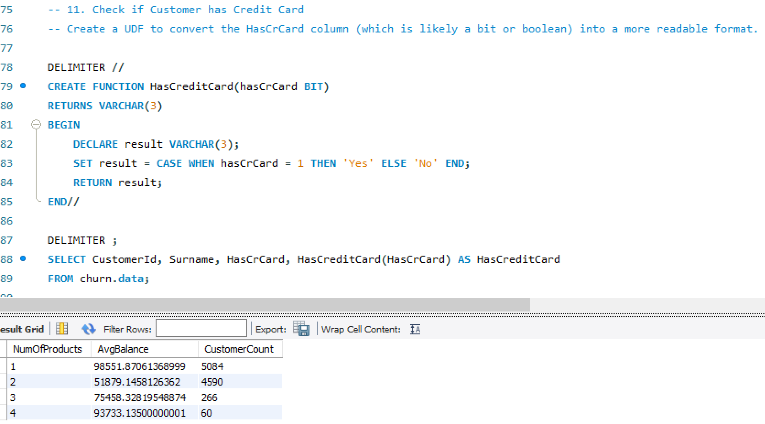
Explanation: A user-defined function (UDF) in SQL is a function that a user writes and the database software executes. UDFs can perform specific tasks, such as complex calculations or data processing. They can accept inputs, perform actions, and return the output in various forms, such as a single value or a result set. Here UDF is created Check if Customer has Credit Card or not by specifying Boolean condition.
Code:

Slide 21
Q12. Explore Customer Demographics and Churn
Objective: Investigate the relationship between customer demographics (gender, age) and churn.
Query: WITH DemographicsChurn AS (
SELECT
Gender,
Age,
AVG(Exited) * 100 AS ChurnRatePercentage
FROM churn.data
GROUP BY Gender, Age
)
SELECT Gender, Age, ChurnRatePercentage
FROM DemographicsChurn
ORDER BY Gender, Age;
Method Used: Select Statement, CTE, Average Function, Order By Clause

Slide 22
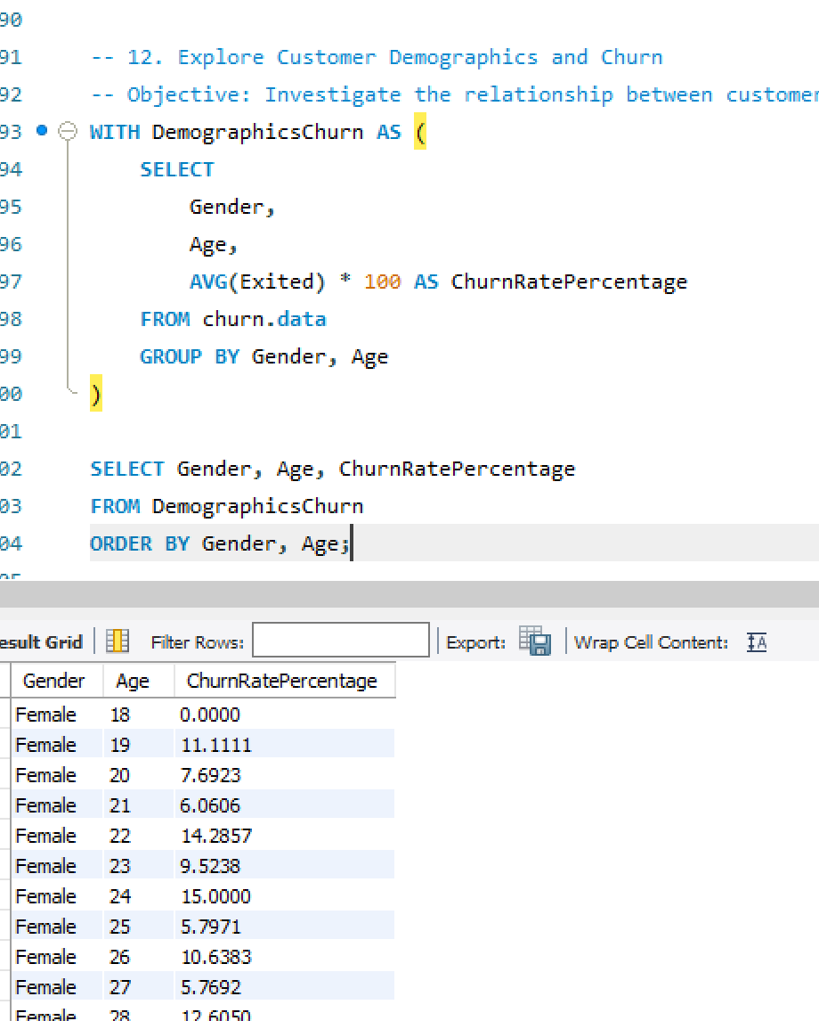
Explanation: A Common Table Expression (CTE) in SQL is a temporary result set that can be referenced within a SELECT, INSERT, UPDATE, or DELETE statement. CTEs are defined using the WITH keyword and allow you to create a named, reusable subquery within your SQL statement Here CTE is created to Explore Customer Demographics and Churn Objective by calculating ChurnRatePercentage condition.
Code:

Slide 23
Q13. Determine Customer Tenure and Estimated Salary Trends
Objective: Analyze the relationship between customer tenure and estimated salary.
Query: WITH TenureSalaryAnalysis AS (
SELECT
Tenure,
AVG(EstimatedSalary) AS AvgEstimatedSalary
FROM churn.data
GROUP BY Tenure
)
SELECT Tenure, AvgEstimatedSalary
FROM TenureSalaryAnalysis
ORDER BY Tenure;
Method Used: Select Statement, CTE, Average Function, Order By Clause

Slide 24
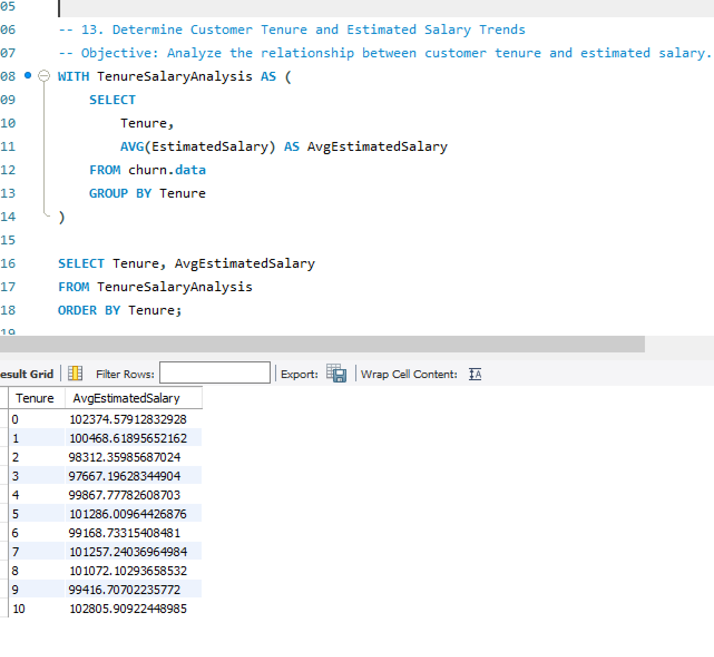
Explanation: A Common Table Expression (CTE) in SQL is a temporary result set that can be referenced within a SELECT, INSERT, UPDATE, or DELETE statement. CTEs are defined using the WITH keyword and allow you to create a named, reusable subquery within your SQL statement. Here CTE is created to determine Customer Tenure and Estimated Salary Trends by Analyzing the relationship between customer tenure and estimated salary
Code:

Slide 25
Q14. Analyze Customer Age Distribution
Objective: Calculate the count of customers in different age groups.
Query: WITH AgeDistribution AS (
SELECT
CASE
WHEN Age < 30 THEN 'Under 30’
WHEN Age >= 30 AND Age < 40 THEN '30-39’
WHEN Age >= 40 AND Age < 50 THEN '40-49’
ELSE '50 and over’
END AS AgeGroup,
COUNT(*) AS CustomerCount
FROM churn.data
GROUP BY AgeGroup
)
SELECT AgeGroup, CustomerCount
FROM AgeDistribution
ORDER BY AgeGroup;
Method Used: Select Statement, CTE, Average Function, Order By Clause

Slide 26
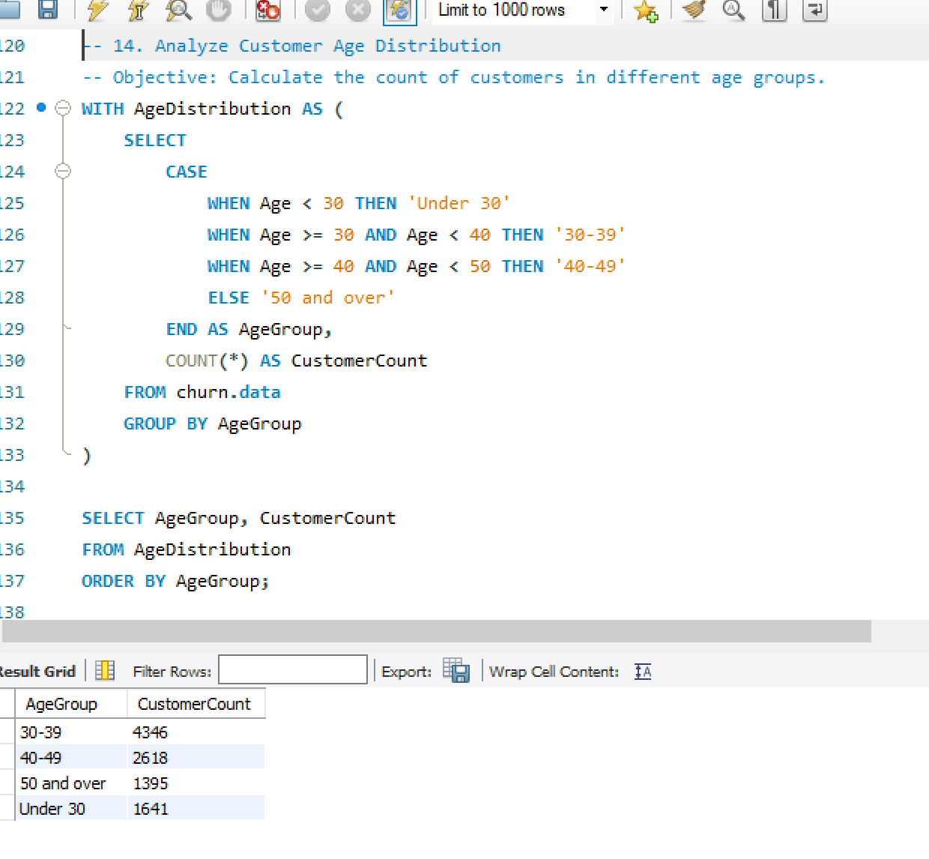
Explanation: A Common Table Expression (CTE) in SQL is a temporary result set that can be referenced within a SELECT, INSERT, UPDATE, or DELETE statement. CTEs are defined using the WITH keyword and allow you to create a named, reusable subquery within your SQL statement. Here CTE is created to Analyze Customer Age Distribution in various groups and Calculating the count of customers in different age groups.
Code:

Slide 27
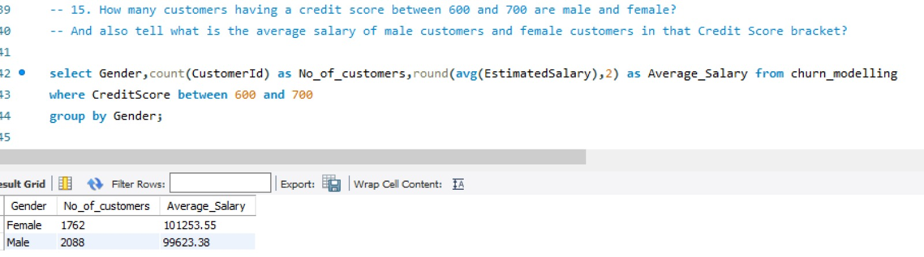
Q15. How many customers having a credit score between 600 and 700 are male and female? And also tell what is the average salary of male customers and female customers in that Credit Score bracket?
Query: select Gender,count(CustomerId) as No_of_customers,round(avg(EstimatedSalary),2) as Average_Salary from churn.data
where CreditScore between 600 and 700
group by Gender;
Method Used: Select Statement, Round Function , Count Function, Average Function, Group By Clause
Explanation: To Retreive the values calculated for customers having a credit score between 600 and 700 are male and female and also calculating the average salary of male customers and female customers in that Credit Score

Slide 28
Q16. How many male and female customers have been churned out in different Countries in different age brackets?
# age is between 18 and 30 .....Young
# age is bweteen 30 to 45.....Adults
# age is between 45 to 60.....MiddlE_Aged
#>60..........................Senior_Citizens
Query: with ABC as
(select *,
case when Age>=18 and Age<30 then "Young"
when Age>=30 and Age<45 then "Adult"
when Age>=45 and Age<60 then "Middle_Aged"
else "Senior_Citizen"
end as Age_bracket
from churn.data)
select Gender,Geography,Exited,count(CustomerID) as Churned_customers from ABC
group by Gender,Geography,Exited
having Exited = 1
order by Gender, Geography;

Slide 29
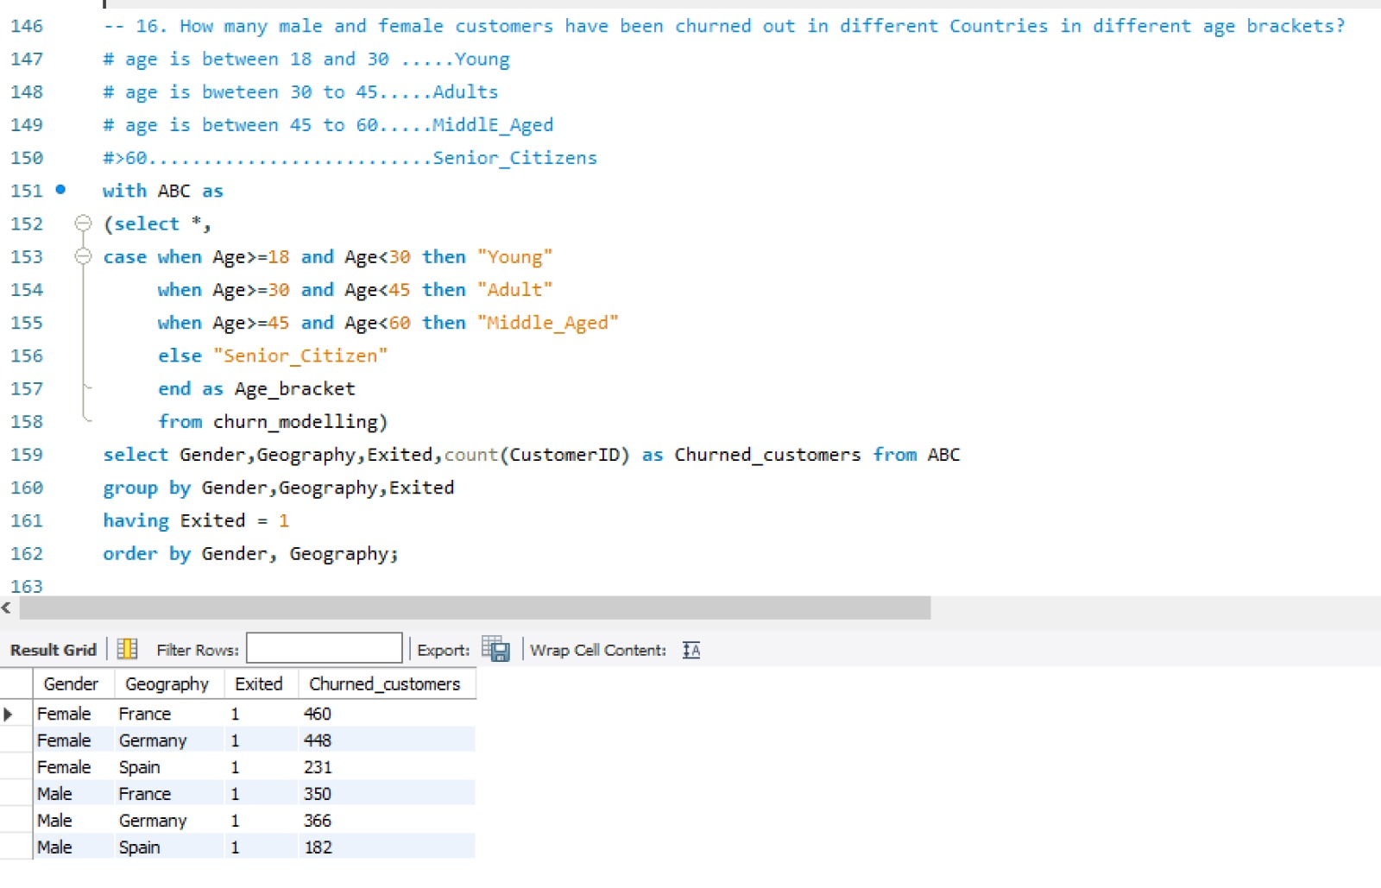
Method Used: Select Statement, CTE, Average Function, Order By Clause
Explanation: A Common Table Expression (CTE) in SQL is a temporary result set that can be referenced within a SELECT, INSERT, UPDATE, or DELETE statement. CTEs are defined using the WITH keyword and allow you to create a named, reusable subquery within your SQL statement. Here CTE is created to determine Customer Tenure and Estimated Salary Trends by Analyzing the relationship between customer tenure and estimated salary
Code:

Slide 30
CONCLUSION
In this project, we conducted Data Analysis on Churn dataset by using SQL queries in mysql. The objective was to extract meaningful insights and metrics from the Dataset. We performed various tasks such as joining tables, Aggregating Data, Filtering Records and Sorting results to fulfil specific analysis requirements.
Throughout the project, we demonstrated proficiency in SQL query writing, leveraging a variety of SQL functions, clause, Operators, Analyze the dataset effectively. We Utilized Common Table Expressions(CTE), Aggregation Functions (eg: SUM,AVG) and Local Operations to extract insights such as Total revenue, Top-selling categories, and Customer behaviour patterns.

Slide 31
EXPLORATORY DATA ANALYSIS ON THE churn DATA

Slide 32
OBJECTIVES
he necessary modules.
Importing the data from an external source into the Python environment.
Renaming the variables as per the Naming conversion.
Performing necessary Datatype Conversions on the data.
Checking the relevant and irrelevant variables in the first phase of EDA.
Data Duplicacy: Chech if their is duplicate data or not: DDT ( DataDuplicacy Treatment)
Missing Values Treatment.
Separating the categorical Variables and Numerical variables into two different datasets for Data Preparations for Data Analysis.
Filling missing values in Numerical data with the Median values.
Filling missing values in Categorical data with the Mode values.
Visualizing relationship of variables using Matplotlib.pyplot
Outlier Treatment.

Slide 33
Importing all the necessary modules.
To importing necessary modules in python, we use “import” statement followed by the name of the module.
numpy : it is used for numerical computing. It provides support for large, multi-dimensional arrays and matrices. In numpy data structure allows Broadcasting and Vectorization
Importing numpy: import numpy as np
pandas: it is a powerful library in python for data manipulation and analysis. It provides data structure like data frame and series.
Importing pandas: import pandas as pd
Matplotlib.pyplot : which is used for creating static,interactive and visualization in python.
Matplotlib offers a wide range of plotting functions to create various types of plots such as Line plot, Scatter plot, Bar plot, Histogram and Pie chart.
Importing matplotlib: import matplotlib.pyplot as plt
Datetime: for the datetime data we import datetime.

Slide 34
Importing datetime : import datetime as dt
seaborn : it is a statistical data visualization module.
Seaborn simplifies the creation of complex visualization.
Box plot, Tree map, Heat maps are used to check correlations between multiple variables.
Importing seaborn : import seaborn as sns
Statsmodels: This module provides a high-level interface for specifying statistical modules using a formula.
Importingstats models : import statsmodels.formula.api as smf
Sklearn: it can implement and evaluate a wide range of ML models with ease, leveraging its robust and efficient algorithms and utilities.
Importing Sklearn :fromsklearn import datasets, linear_model
Importing Machine Learning modules:
Logistic Regression:
from sklearn.linear_model import LogisticRegression
from sklearn.metrics import accuracy_score,confusion_matrix,classification_report,roc_auc_score,roc_curve
from sklearn.metrics import f1_score, roc_auc_score, confusion_matrix, accuracy_score

Slide 35
Decision Tree:
From Sklearn.Tree Import DecisionTreeClassifier
From Sklearn.Metrics Import Confusion_matrix
From Sklearn.Tree Import DecisionTreeClassifier, Export_graphviz, Export_text
From Sklearn.Neighbors Import KneighborsClassifier
From Sklearn.Model_selection Import GridSearchcv, Train_test_split
From Sklearn.Preprocessing Import StandardScaler, Minmax_scale
K-nearest Neighbors Classifier:
From Sklearn.Neighbors Import KneighborsClassifier
From Sklearn.Model_selection Import GridSearchcv, Train_test_split
From Sklearn.Preprocessing Import StandardScaler, Minmax_scale
Random Forest Classifier:
From Sklearn.Ensemble Import RandomForestClassifier
Naive Bayes Algorithm:
From Sklearn.Naive_bayes Import Gaussiannb
Gnb = Gaussiannb()

Slide 36
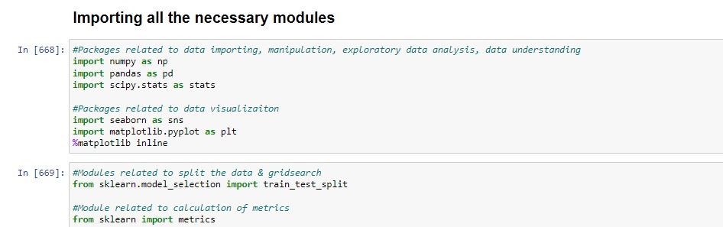
CODE

Slide 37
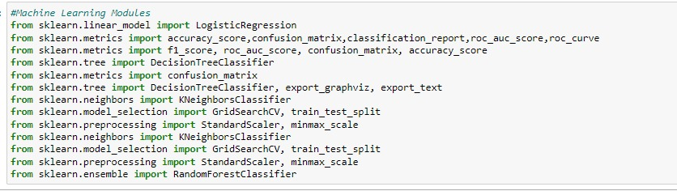

Slide 38
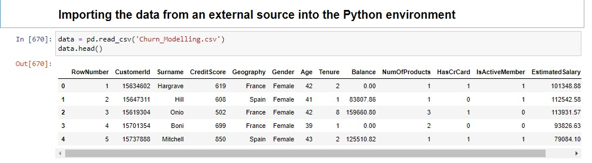
Importing the data from an external source into the Python environment
To import data from an external source into a python environment, we use various methods depending on the type and format of the data.
In this project data is in the format of csv file. To read csv files using the read_csv() function

Slide 39
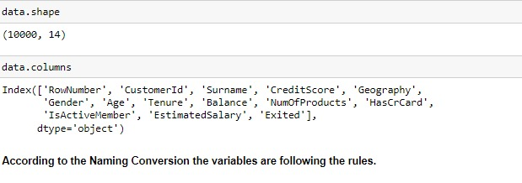
Renaming the variables as per the Naming conversion.
According to the naming conversion :
Names should be starting with alphabets.
Do not use special characters except underscore.
There is no spacing between the names.

Slide 40
In this Data follows the naming conversion
Getting the summary of the data frame , data.info() is used to get the concise summary of the Dara frame.
It provide information such as :
The total number of entries in each column.
The data type of each column.
The count of non-null values in each column.
The memory usage of the data frame

Slide 41
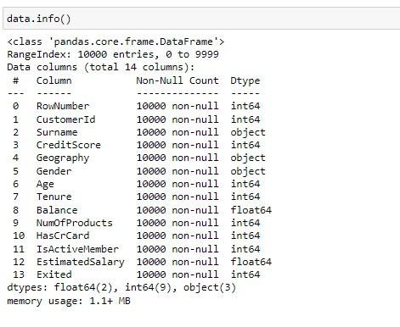

Slide 42
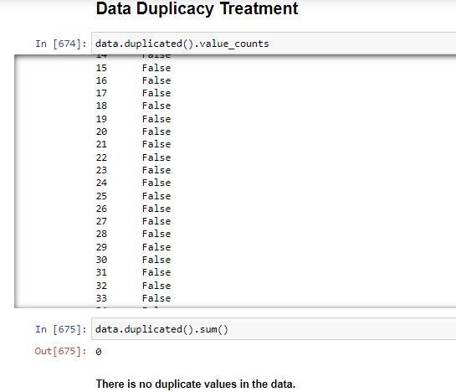
Data Duplicacy : Check if their is duplicate data or not: DDT (Data Duplicacy Treatment)
In this churn data there is no duplicate values. The data contain 10000 records and 14 variables.

Slide 43
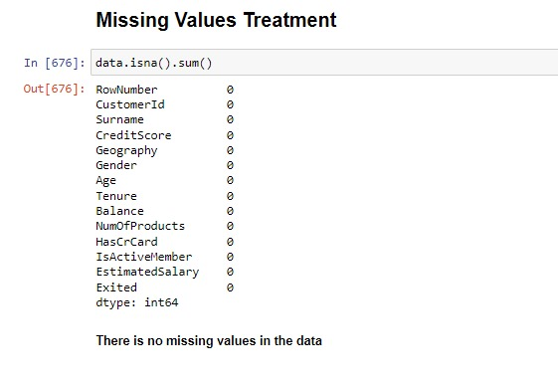
MISSING VALUE TREATMENT

Slide 44
checking the value count and nunique of categorical variable
In the first phase of Exploratory Data Analysis (EDA), determining relevant and irrelevant variables is crucial for understanding the dataset and shaping further analysis.
Data.nunique() is used to count the number of unique values in a data frame or series.
Value _counts() is used to count the occurrences of unique values .

Slide 45
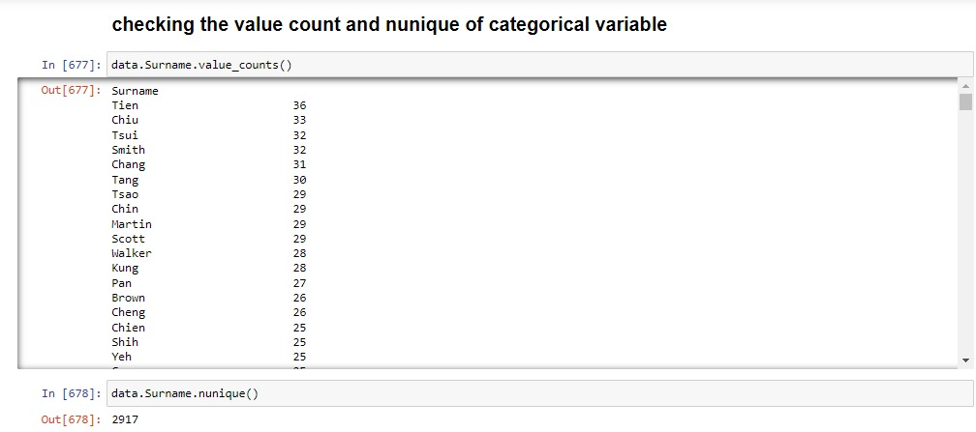
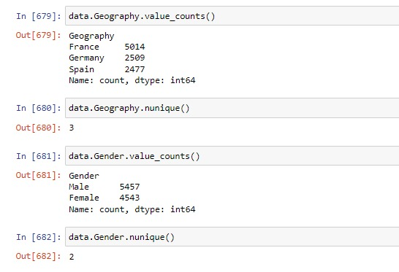
CODE

Slide 46
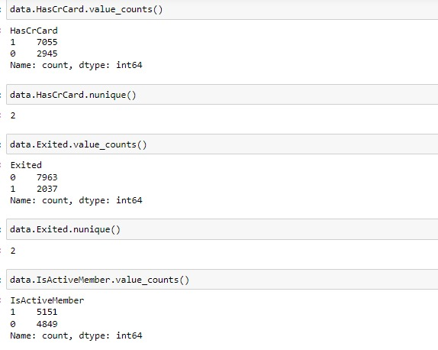
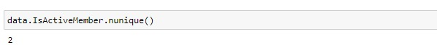

Slide 47
Visualizing relationship of variables using Matplotlib.pyplot.
Matplotlib.pyplot : which is used for creating static, interactive and visualization in python.
Matplotlib offers a wide range of plotting functions to create various types of plots such as Line plot, Scatter plot, Bar plot, Histogram and Pie chart.
Line plot: Line plot display data points connected by straight line segment. It commonly used to visualize the relationship or trends.
Scatter plot: Scatter plot is used to show the correlation between two numerical variables.
Bar plot: Bar plot is used for comparison analysis. It shows the relation between one numerical variable and one categorical variable.
Histogram: Histograms are very helpful to see the frequency distribution by only numerical variable.
Pie chart: used for showing the percentage distribution of a numerical variable by one categorical variable.

Slide 48
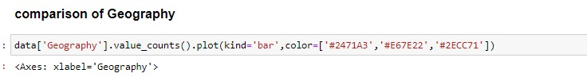
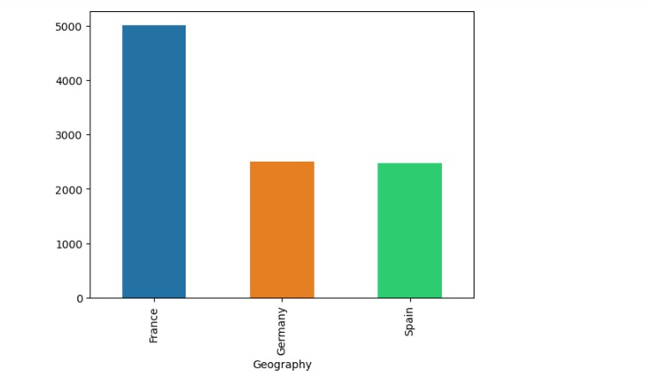

Slide 49
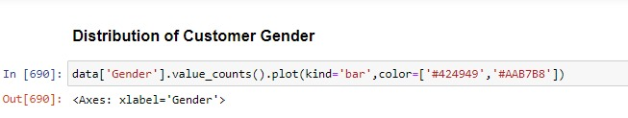
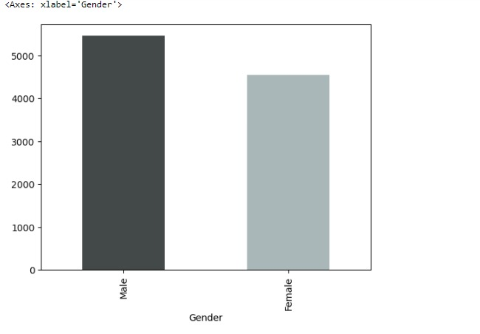

Slide 50
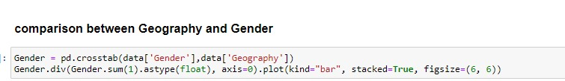
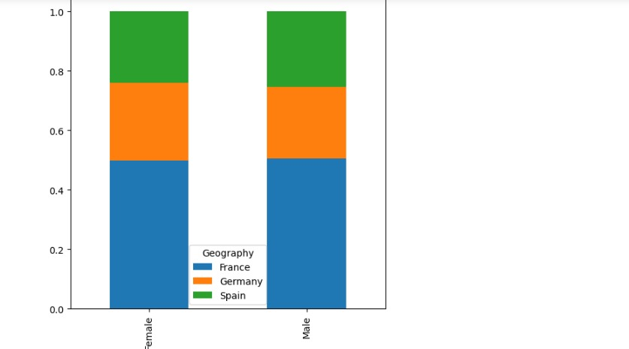

Slide 51
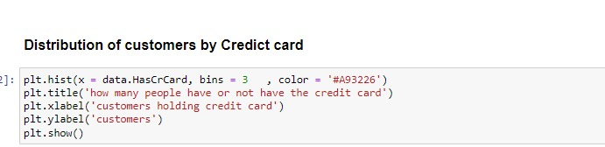
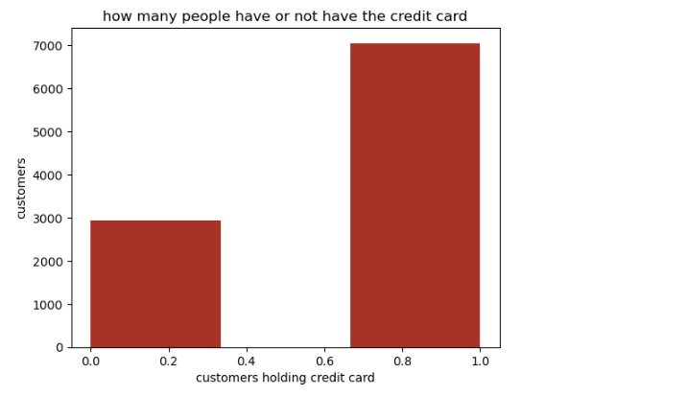

Slide 52
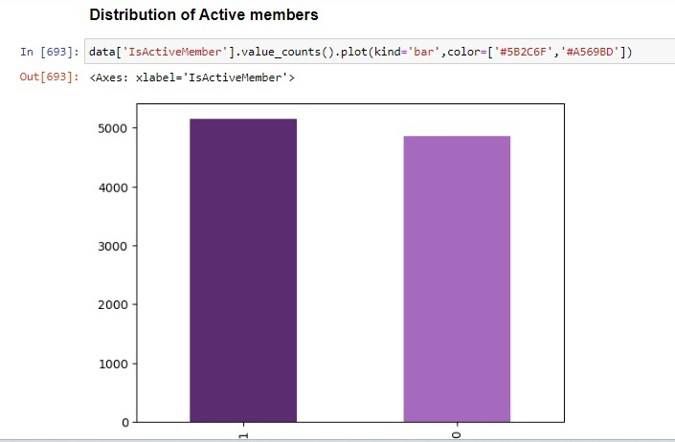

Slide 53
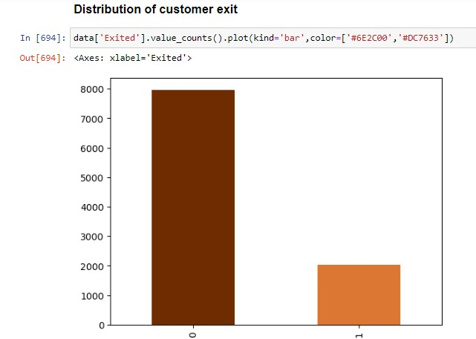

Slide 54
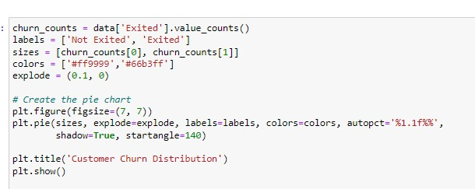
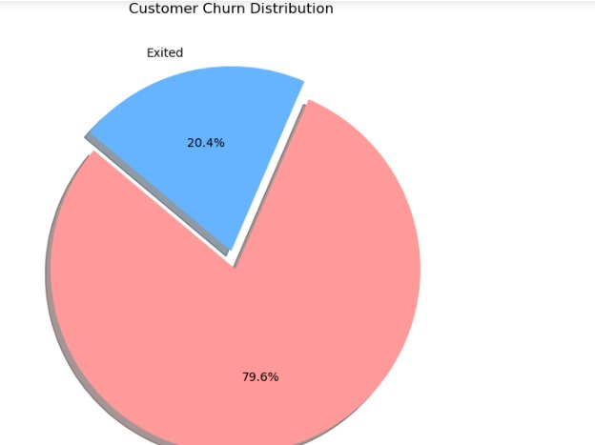
Customer Churn Distribution

Slide 55
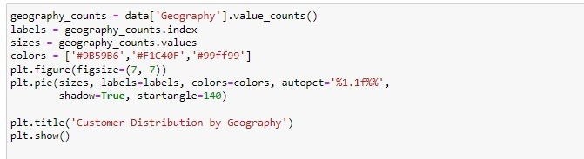
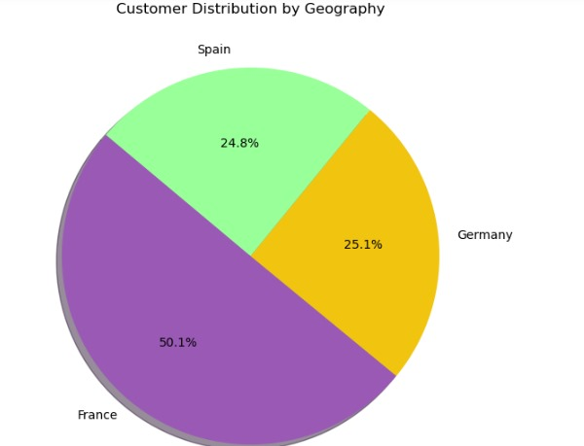
Customer Distribution by Geography

Slide 56
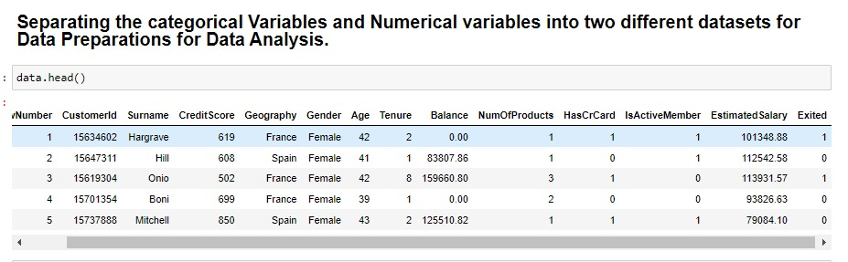
Separating the categorical Variables and Numerical variables into two different datasets for Data Preparations for Data Analysis

Slide 57
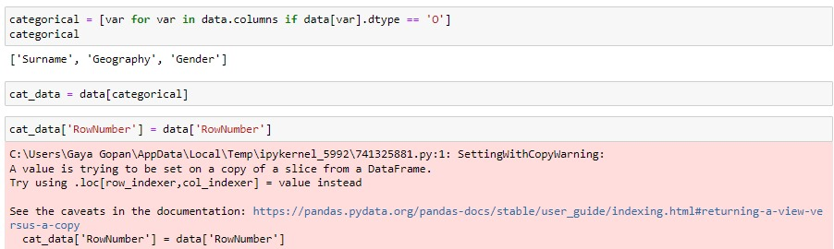
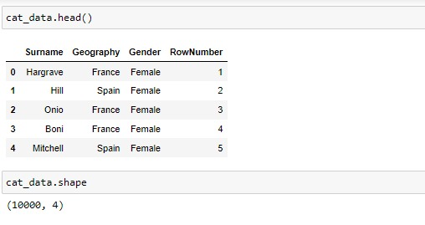

Slide 58
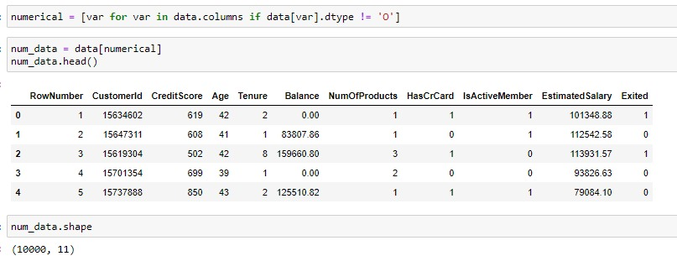

Slide 59
OUTLIER TREATMENT.
In python outlier is a data point that significantly differ from other observations in a dataset.
Outlier is a value either very large or either very small.
To perform outlier treatment using the interquartile range (IQR) method .
Mean of the data gets affected by the outlier and median not affected much.

Slide 60
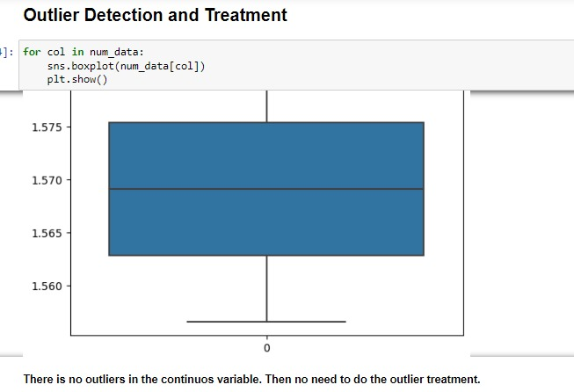
There no outliers in our data.

Slide 61
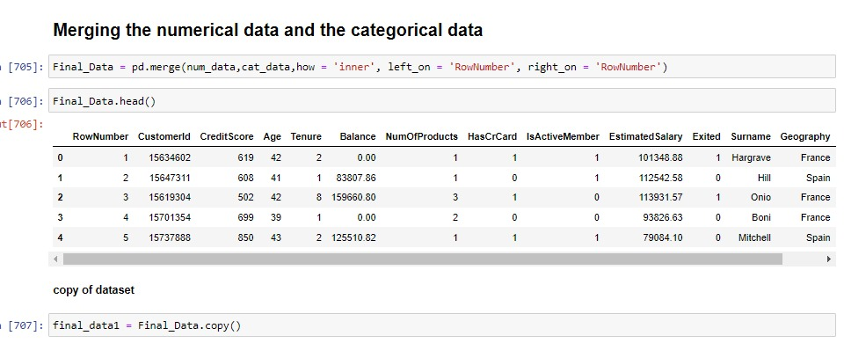
Merging the numerical data and the categorical data

Slide 62
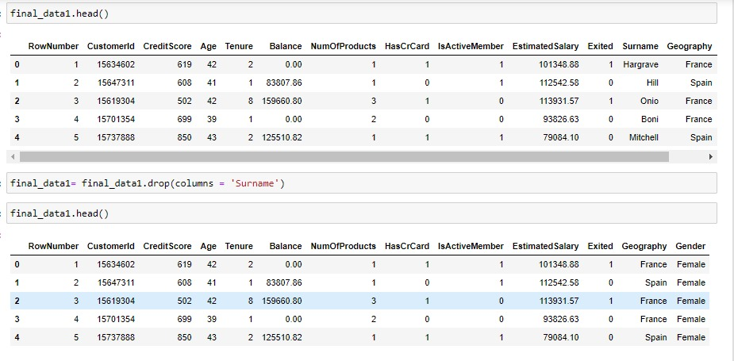
After merging the numeric and categorical data we get Final Data. Make a copy of final data to safe the original data.

Slide 63
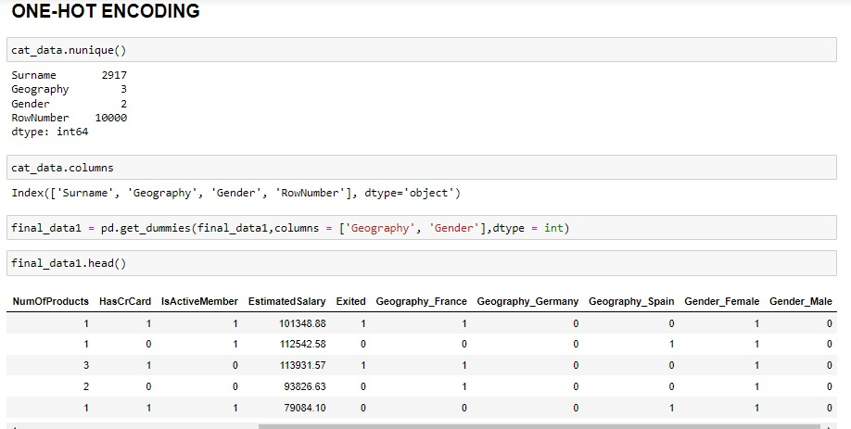
ONE-HOT ENCODING
One-hot encoding is a technique used to convert categorical variables into a numerical format that can be used in machine learning models. It creates a binary column for each category and assigns a 1 or 0 to indicate the presence of a category in a given sample.
creating dummy variables is a crucial step in preprocessing categorical data for machine learning models, ensuring that the data is in a suitable numerical format without imposing any unintended order or hierarchy.

Slide 64
Feature Engineering
Feature Engineering is a part of EDA in which we try to remove the less important feature and take only the relevant and important variable or feature.
Correlation Analysis :
The correlational coefficient indicates the strength and direction of the relationship.
The range of correlational analysis is -1 to 1.
1 indicates perfect positive correlation.
-1 indicates perfect negative correlation.
0 indicates no linear relationships.
Selecting the important feature by choosing a cut of value of 0.03

Slide 65
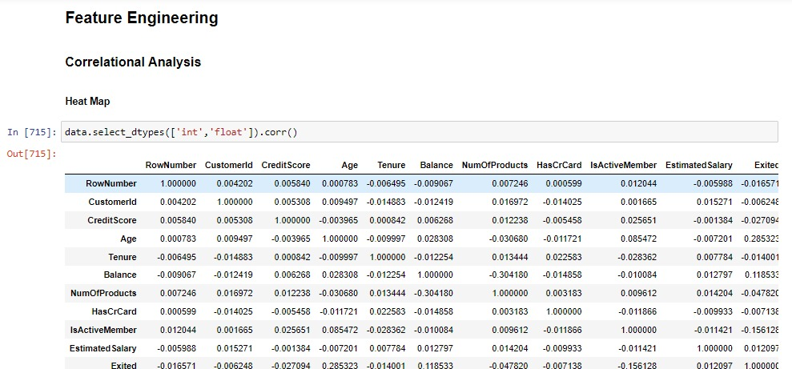

Slide 66


Slide 67


Slide 68


Slide 69


Slide 70
Splitting the final dataset into Training and Testing dataset
Divide the dataset into separate subset for Training, Validation, Testing dataset.
Training dataset :
The largest portion of the dataset (70-80% of total dataset).
Learn patterns, relationships and characteristics from the set.
Validation dataset :
10-15% of the dataset.
Optimizing model performance without overfitting the training data.
Testing dataset :
Evaluating the final model’s performance on unseen data.
10-15% of the total data.

Slide 71


Slide 72
Machine Learning Modelling

Slide 73
Machine Learning Modelling
Logistic Regression
Decision Tree
K-Nearest Neighbors Classifier
Random Forest Classifier
Naive Bayes

Slide 74
Logistic Regression
Logistic Regression is a supervised Machine Learning Algorithm .
It is used for binary classification problems, where the target variable is categorical with two possible outcomes.
Where the goal is to predict the probability of one of two possible outcomes.
In Churn data analysis we take a target variable as “Exited”. The customers who were churn out from the organization.

Slide 75

CODE
In this analysis we get a Accuracy of 70.52%.

Slide 76
Decision Tree
Decision Tree is a supervised machine learning algorithm.
It is used for both classification and regression tasks.
In this analysis we can conclude that the Training accuracy is 100% and the Testing accuracy is 82.12%. Therefore, the difference between training and testing accuracy is more. It is an overfitted model.

Slide 77

CODE

Slide 78
K-Nearest Neighbores classifier
KNN is a supervised machine learning algorithm.
It is the simplest machine learning algorithm.
It is a distance based algorithm.
In distance based algorithm always do the standardisation.
In KNN classifier we don’t want to do any feature engineering.

Slide 79

CODE

Slide 80


Slide 81
Random forest classifier
Random forest is a supervised machine learning algorithm.
It is a collection of multiple decision tree.
In this analysis the training accuracy is 100% and testing accuracy is 85.5%. It shows the difference between the training and testing accuracy is more. The model is overfitted.

Slide 82

CODE

Slide 83
Naïve bayes algorithm
Naïve bayes is a supervised learning algorithm.
It is based on the Bayes Theorem.
Gaussian Naïve Bayes is used for the analysis of the data, the features follows a normal distribution.
In this analysis the training accuracy is 74.51% and the testing accuracy is 72%. It shows that the difference between testing and training accuracy is only 2.51%. Therefore it is a good model.

Slide 84

CODE

Slide 85

Confusion matrix
It is a table that shows the number of correct and incorrect prediction made by the model compared with the actual classification.

Slide 86


Slide 87
TP: (True Positive) number of outcomes that are actually positive and predicted as positive. Here 4551 outcomes are TP.
FN:(False Negative) number of outcomes are actually positive but predicted as negative. Here 793 outcomes are FN.it is also known as Type 2 error.
TN:(True Negative) number of outcomes are actually negative and predicted as negative. Here 1037 outcomes are TN.
FP:(False Positive) number of outcomes that are actually negative but predicted as positive. It is also known as Type 1 error. Here 1119 outcomes are FP.

Slide 88

CODE
Training accuracy

Slide 89

Here the training accuracy is 74.51% and testing accuracy is 72%. It shows that the difference between training and testing accuracy is less. Therefore it is a good model.

Slide 90

Comparison analysis
Different algorithms may perform differently depending on the data and the problem domain. Comparing algorithms helps identify which model achieves the best performance.

Slide 91

CODE

Slide 92
Conclusion
The Chun data modeling analysis provided valuable insights into the strengths and weaknesses of various machine learning algorithms. By carefully evaluating and comparing these models, Naïve Bayes algorithm is gives the best model.
The Chun data modeling analysis provided valuable insights into the strengths and weaknesses of various machine learning algorithms. By carefully evaluating and comparing these models, Naïve Bayes emerged as the most effective solution for predicting churn out customers. The findings underscore the importance of considering multiple aspects, including performance, efficiency, robustness, and interpretability, in the model selection process. Moving forward, continuous improvement and adaptation will be key to leveraging the full potential of the chosen model.

Slide 93
THANK YOU - -Dhivya

